Slide 1
Automated Resume Ranking System:

Slide 2
Agenda
What is ARRS?
Why am I choosing ARRS?
Summary of Research
Overall Architecture
Model Validation
Final Outcome
Potential benefits
Link of Code base

Slide 3

What is ARRS?
Welcome to the evolution of Automated Resume Ranking System. Explore the impact of technology on talent acquisition and the future of recruitment strategies.
Automated Resume Ranking System

Slide 4
Why am I choose ARRS
Industry Challenges: Helping companies quickly find the right people instead of spending too much time looking at resumes.
Using Technology: Using advanced tool to make HR tasks easier, like understanding resumes better and making better choices about who to hire.
Personal Interest: I really like finding new ways to make HR work better using technology.
Market Demand: People want faster, better ways to hire employees, and this idea fits that need.
Learning Opportunity: This project will help me become really good at analyzing data, using advanced tool, and coming up with new ideas to make HR work better.
Automated Resume Ranking System

Slide 5
Summary Of Research
Literature Review: Combined information from studies about looking at resumes and hiring people.
Best Practices: Identified industry best practices in resume evaluation and candidate selection.
Case Studies: Analyzed real-world examples and case studies of successful recruitment strategies.
Market Trends: Checked out what's happening now in how companies find and choose new employees.
Expert Insights: Got tips from people who know a lot about hiring people, like HR professionals and experienced workers.
Automated Resume Ranking System

Slide 6
Overall Architecture
Automated Resume Ranking System

Slide 7
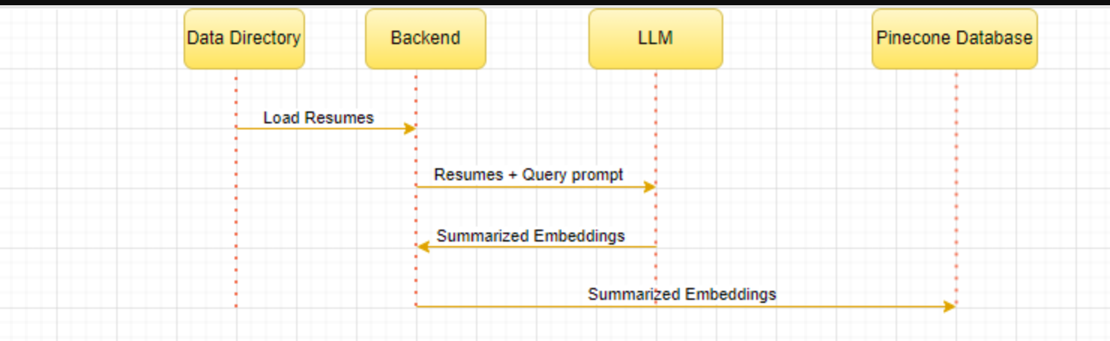
Data Upload Architecture
Automated Resume Ranking System

Slide 8
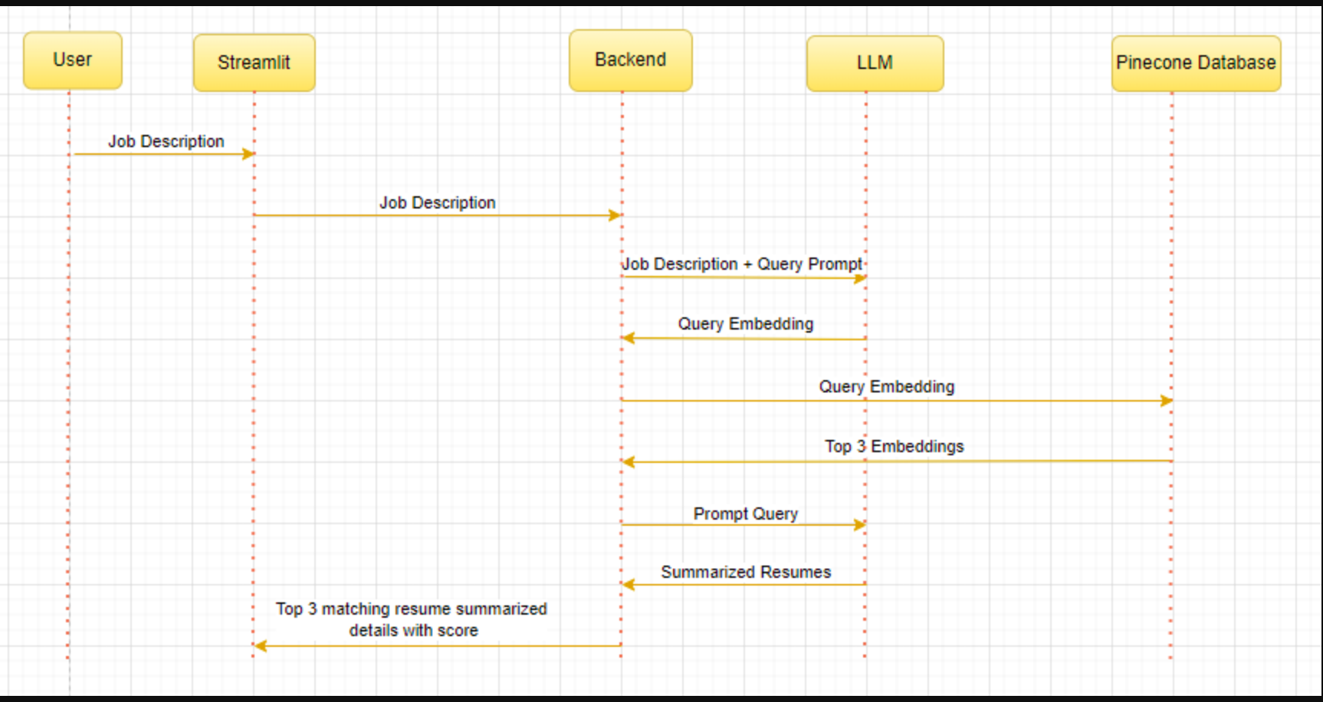
Data Retrieval Architecture
Automated Resume Ranking System

Slide 9
Model Validation
Model Configuration: Set parameters for OpenAI model.
Query Construction: Create query to summarize job description.
Response Analysis: Review model's accuracy in generating responses.
Pinecone Initialization: Prepare database for resume storage.
Embedding Query: Incorporate job description for matching process.
Resumes Retrieval: Fetch resumes from Pinecone database.
Matching Evaluation: Assess resume relevance and similarity of resumes.
Summary Generation Validation: Verify accuracy of extracted information.
Presentation of Results: Communicate findings effectively.
Iterative Improvement: Continuously refine model for better performance.
Automated Resume Ranking System

Slide 10
Final Outcome
Automated Resume Ranking System
Automated Resume Ranking System

Slide 11
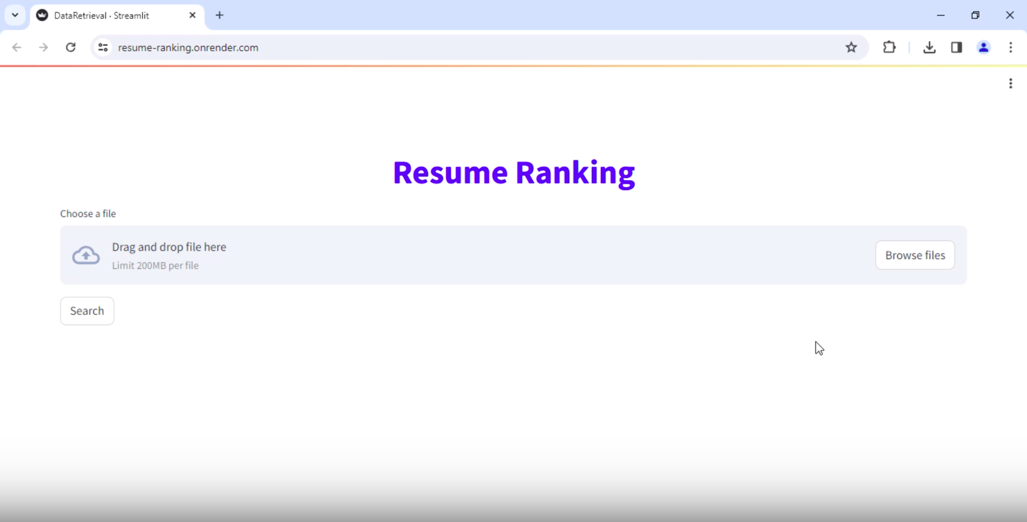
Data Retrieval UI
Automated Resume Ranking System

Slide 12
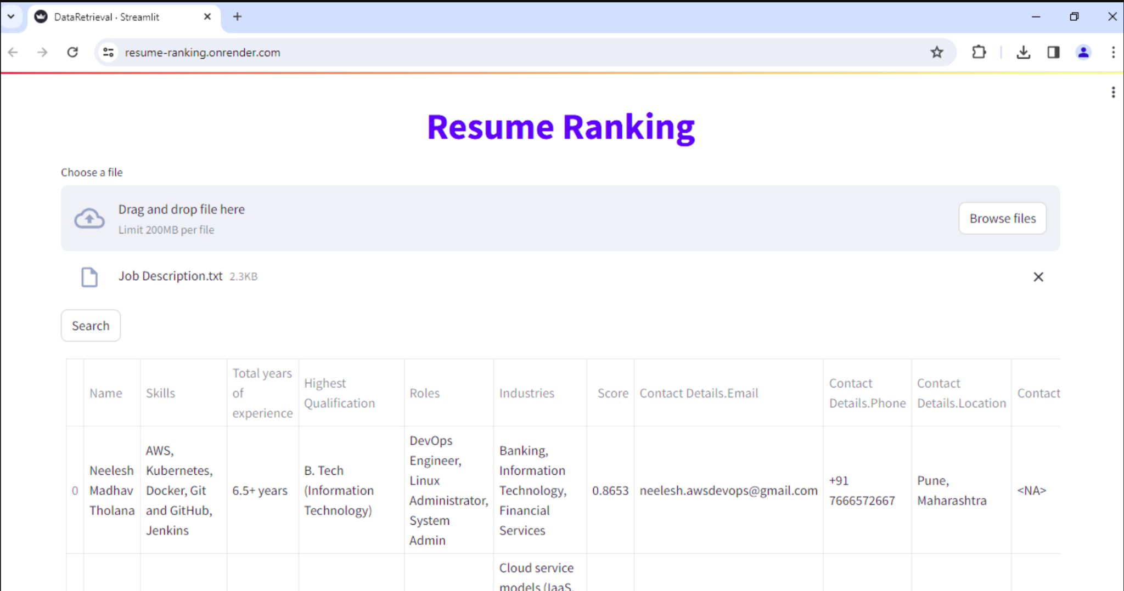
Data Retrieval UI
Automated Resume Ranking System

Slide 13
User Interface Overview
Job Description Input:
Users enter job descriptions.
Pinecone Integration:
Matches job descriptions with candidate data.
Real-time Matching:
Quickly identifies the right candidates.
Candidate Display:
Shows matched candidates' details.
Filtering Options:
Lets users refine candidate search.

Slide 14
What is PineCone
Pinecone: Cloud-Based Vector Database for ML
Purpose: Stores and indexes high-dimensional vectors for efficient querying.
Applications: Ideal for machine learning tasks such as recommendation systems and content matching.
Role in Project: Stores and finds embeddings for resume data, making it easy to compare and match with job descriptions.
Benefits: Speeds up the process of finding similar resumes, making hiring quicker by rapidly identifying top candidates.

Slide 15
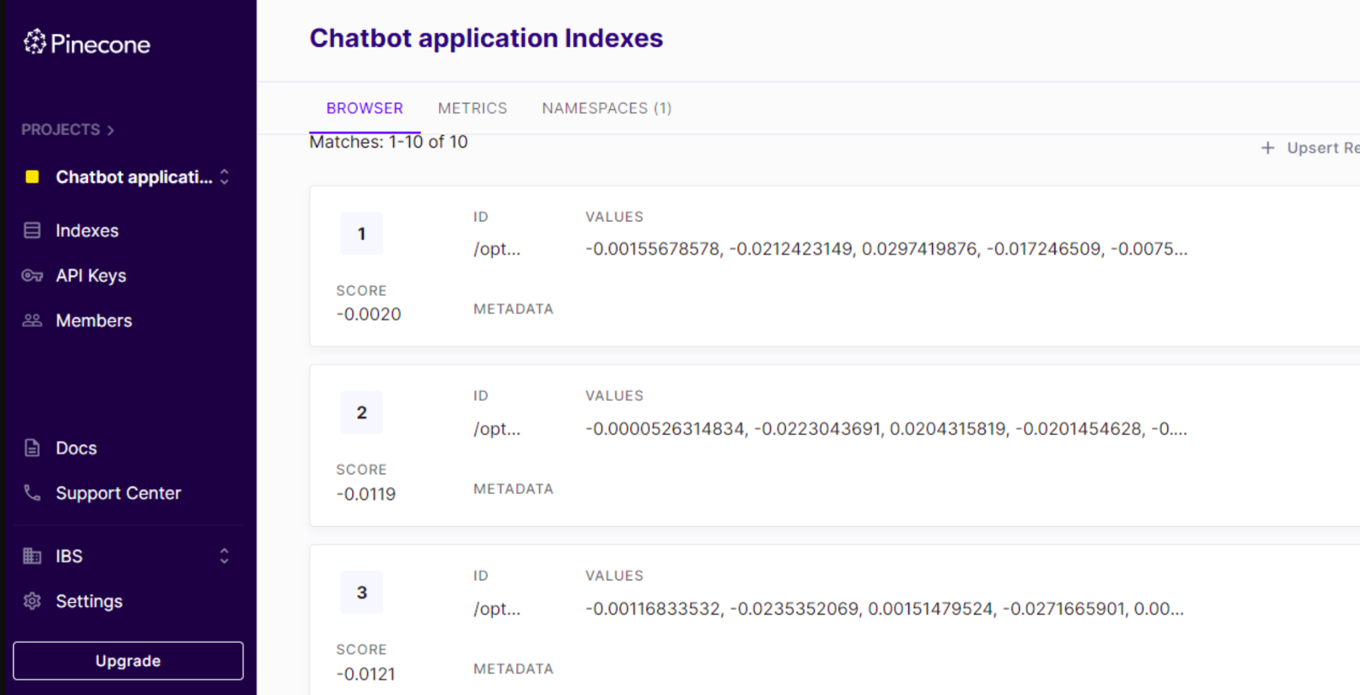
PineCone Database
Automated Resume Ranking System

Slide 16
Potential Benefits
Time Savings: Automates the initial screening process, reducing the time spent on manual review of resumes and allowing recruiters to focus on more important tasks.
Improved Candidate Quality: Ensures that only the most qualified candidates are considered by accurately assessing resumes based on predefined criteria and job requirements.
Scalability: Can efficiently handle large volumes of resumes, making it scalable to meet the demands of high-volume recruitment scenarios without sacrificing quality.
Reduced Bias: Applies consistent evaluation criteria to all resumes, reducing the possibility of showing favoritism and ensuring fair treatment of all candidates throughout the hiring process.
Automated Resume Ranking System

Slide 17
Enhanced Efficiency: Makes hiring faster and smoother by automating repetitive tasks, helping the process run more smoothly.
Data-Driven Decision Making: Gives useful information and analysis on hiring trends, candidate qualities, and which ways of finding people work best, so decisions are based on facts and not just guesses.
Cost Savings: Reduces costs associated with manual resume screening, hiring inefficiencies, and potential recruitment errors, leading to overall cost savings for the organization.

Slide 18
Link Of Code Base
GitHub Link:
https://github.com/sanjanagupta10/Automated-Resume-Ranking-System-.git
Automated Resume Ranking System

Slide 19
Thank you

